Slide 1

H2O Machine Learning & Deep Learning London Workshop
Jo-fai (Joe) Chow
Data Scientist
joe@h2o.ai
@matlabulous
Data Science for IoT Meetup
Barclays Eagle Venture Labs
21st November, 2016

Slide 2
About Me: Civil Engineer → Data Scientist
2005 - 2015
Water Engineer
Consultant for Utilities
Industrial PhD
Water Engineering + Machine Learning
Discovered H2O in 2014!
2015 - Present
Data Scientist
Virgin Media (UK)
Domino Data Lab (US)
H2O.ai (US)
Why? Long story – see bit.ly/joe_h2o_talk2

Slide 3
Agenda
Workshop 1
H2O Introduction
Quick Demo
Step-by-Step Example 1
Binary Classification
Import & Explore
Build & Evaluate
Parameters Tuning
Workshop 2
Example 1 (cont’d)
Grid Search
Model Stacking
Example 2
Anomaly Detection
Other H2O Features

Slide 4
About H2O.ai

Slide 5







About H2O.ai
H2O.ai, the Company
Team: 80
Founded in 2012
HQ: Mountain View, California
H2O, the Platform
Open Source (Apache 2.0)
Algorithms written in Java
Fast, distributed and scalable
Multiple interfaces to suit different users
Web, R, Python, Java, Scala, REST/JSON
Works with desktop/laptop, cloud, Spark and Hadoop

Slide 6
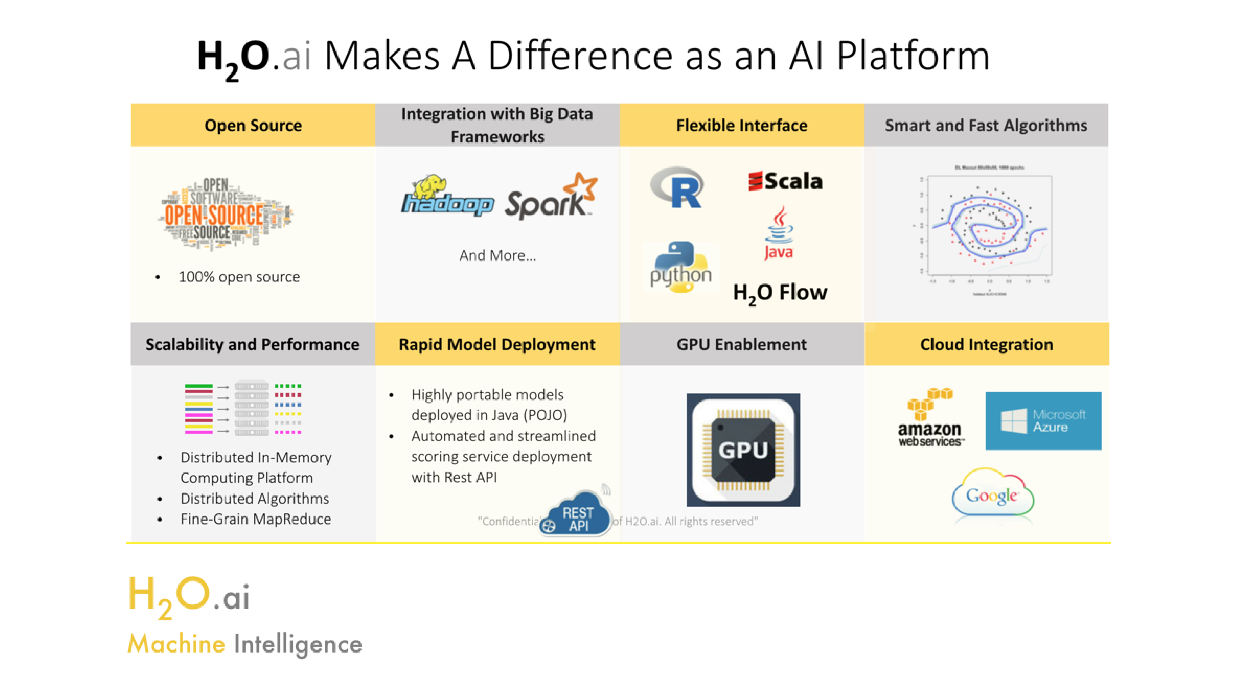

Slide 7
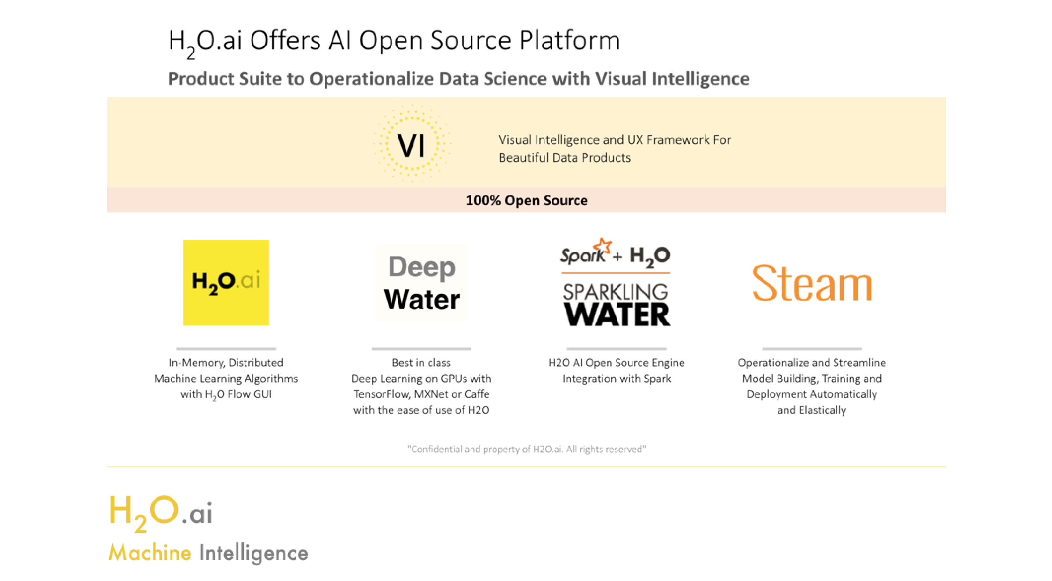

Slide 8


Scientific Advisory Council

Slide 9
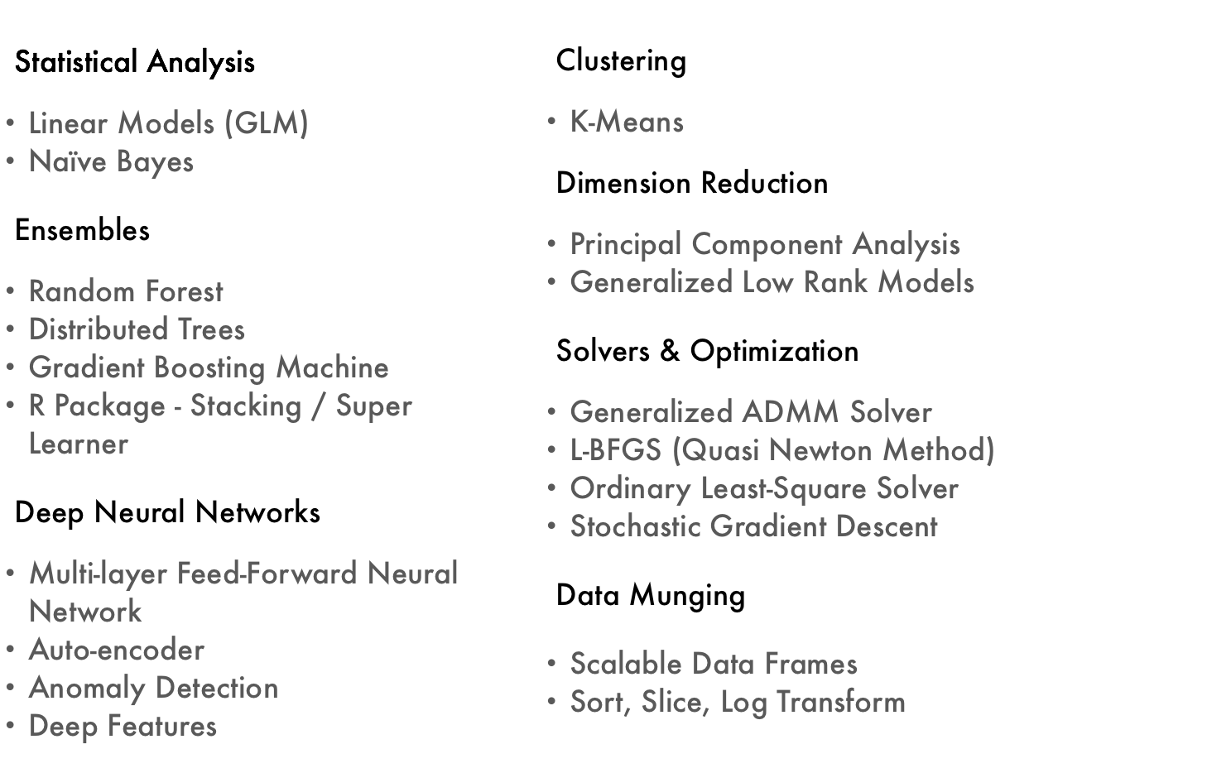
Current Algorithm Overview
Joe’s Strata Hadoop
London Talk
bit.ly/joe_h2o_talk4
Workshop
Joe’s LondonR Talk
bit.ly/joe_h2o_talk3

Slide 10
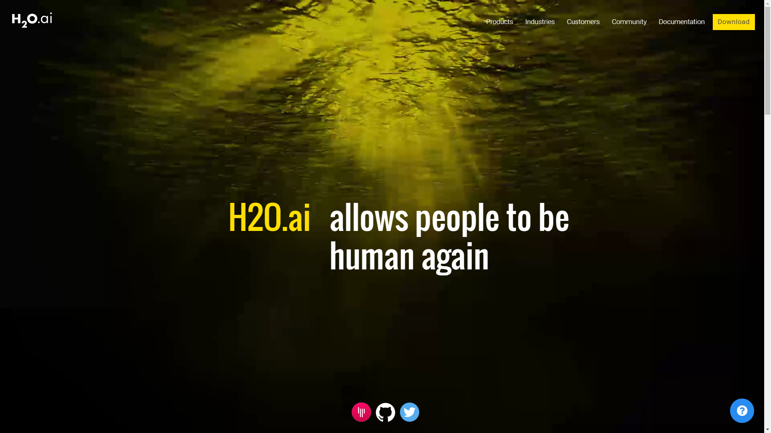

Slide 11


Slide 12
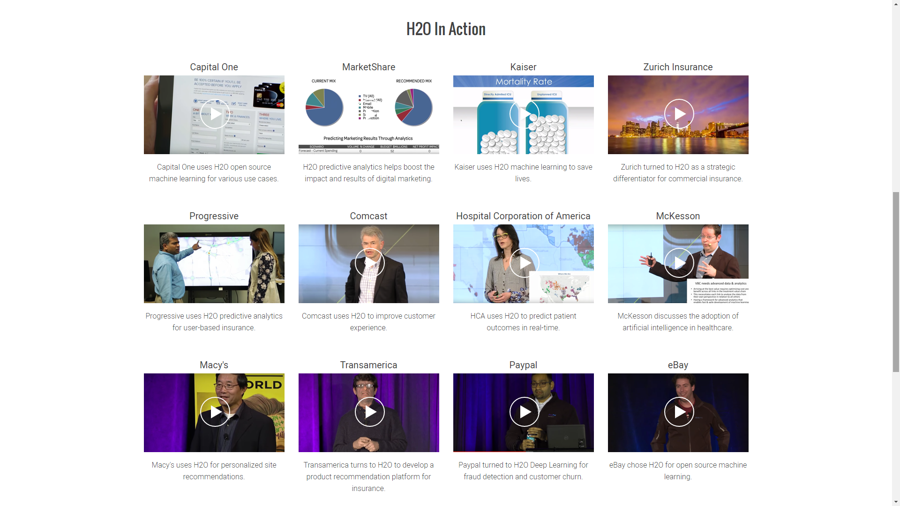
www.h2o.ai/customers

Slide 13


Slide 14
H2O for Kaggle Competitions

Slide 15
H2O for Academic Research
http://www.sciencedirect.com/science/article/pii/S0377221716308657
https://arxiv.org/abs/1509.01199

Slide 16
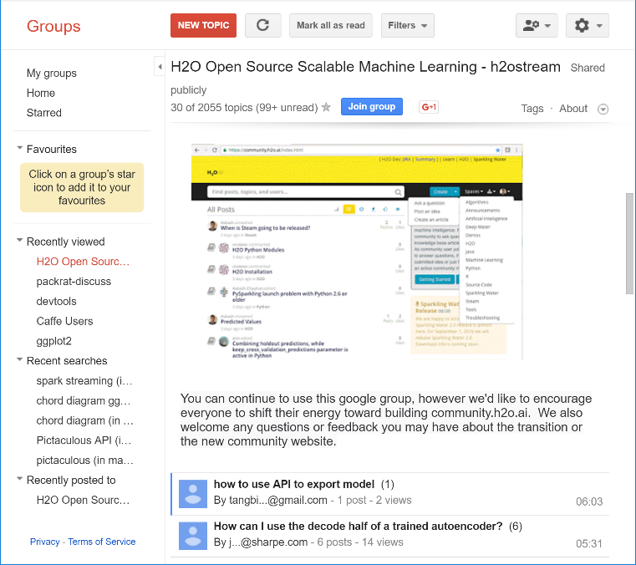
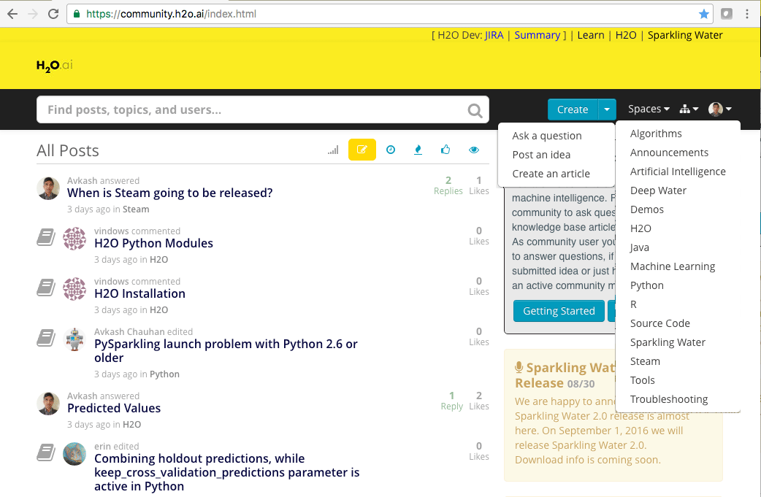
H2O Community Support
Please try
community.h2o.ai
Google forum – h2osteam

Slide 17
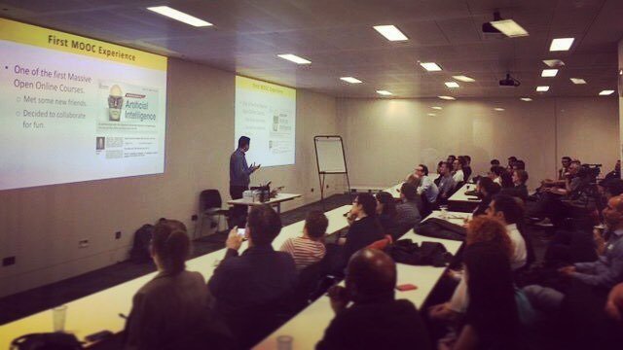
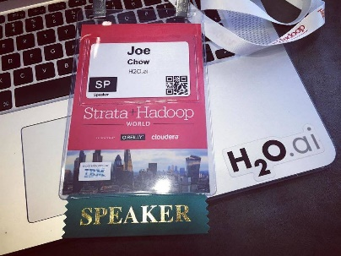
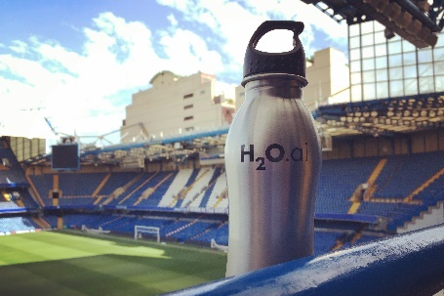

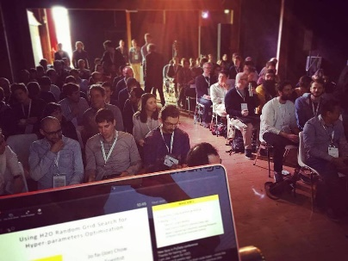
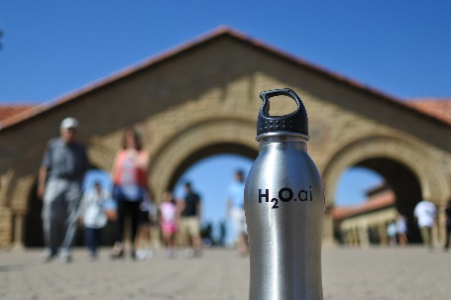
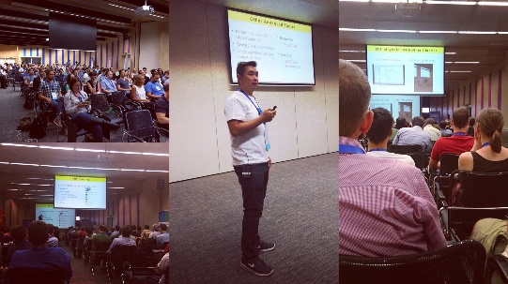
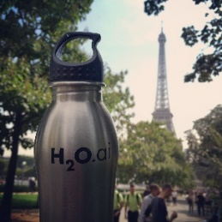
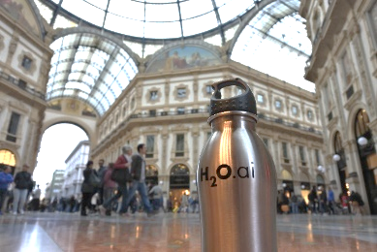
#AroundTheWorldWithH2Oai
London Kaggle Meetup
Strata Hadoop
London
Chelsea FC
Big Data London
PyData
Amsterdam
useR! 2016
Stanford
satRdays
Budapest
Paris ML Meetup
Data Science
Milan

Slide 18
Machine Learning Demo

Slide 19
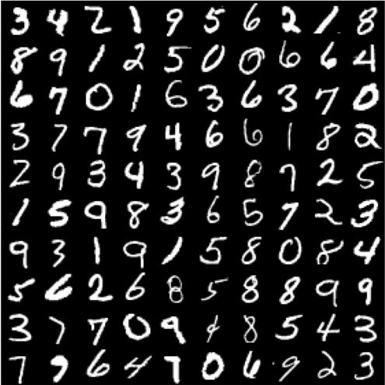
A Typical Machine Learning Task
Demo
Dataset – MNIST
LeCun et al. (1999)
Hand-written Digits
Import & Explore Data
Build & Evaluate Models
Make Predictions
Photo credit: http://www.opendeep.org/v0.0.5/docs/tutorial-classifying-handwritten-mnist-images

Slide 20
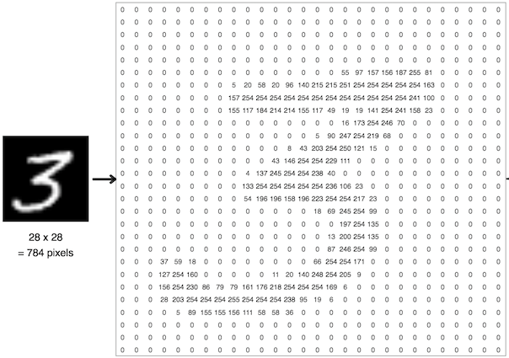
MNIST Hand-Written Digits
784 Inputs
28 x 28 = 784 pixels
1 Output
0, 1, 2, 3, 4, 5, 6, 7, 8 or 9
Classification
Files
Train (42k Records)
Test (28k)
Links
https://www.kaggle.com/c/digit-recognizer/data
Photo credit: https://ml4a.github.io/ml4a/neural_networks/

Slide 21

A Simple Neural Network
Image credit: http://cs231n.github.io/
21

Slide 22
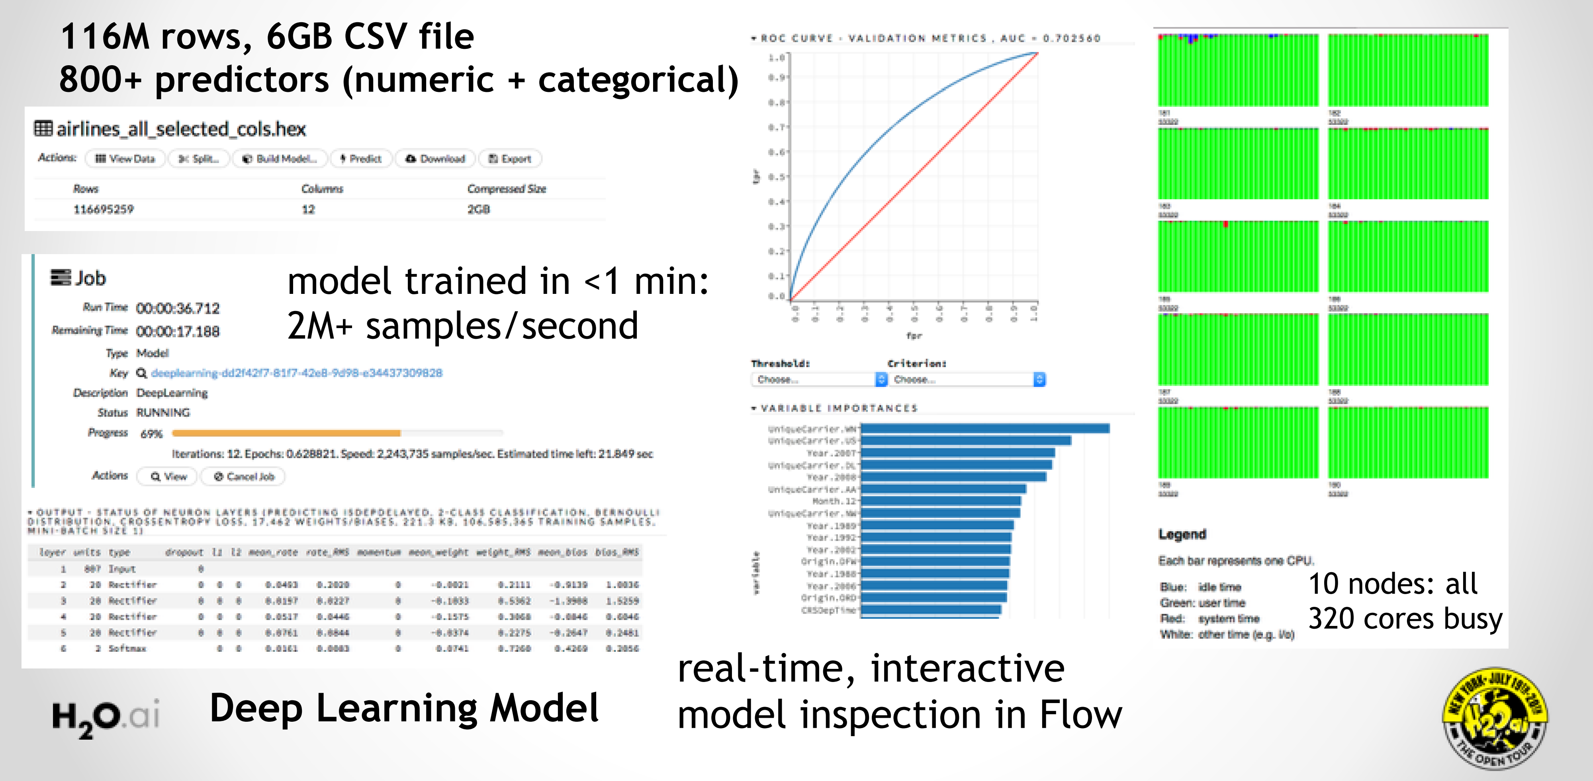
H2O Deep Learning in Action

Slide 23
H2O Flow Demo

Slide 24
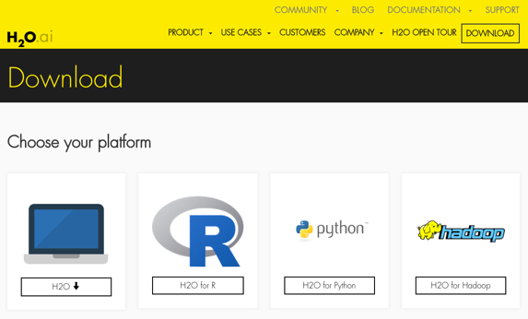
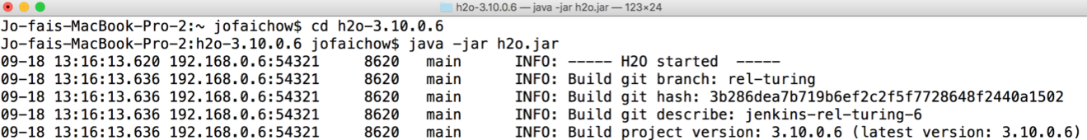
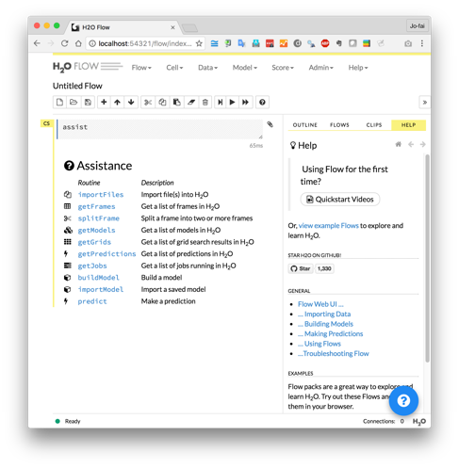
H2O Flow (Web Interface) Demo
Download and unzip jar from www.h2o.ai
In terminal:
java -jar h2o.jar
Web browser:
localhost:54321

Slide 25
H2O Flow Examples

Slide 26
H2O Flow Demo
Tasks:
Import data
Visualize data
Split data
80% training
20% validation
Build models
Tasks:
Evaluate models
Use models for predictions
Grid search

Slide 27
H2O + R Demo

Slide 28
Using H2O’s R Interface
Start a local cluster from R
Import data
Convert integers (0…9) to categorical values
Split dataset for simple validation
Define features and target
R API for H2O Deep Learning
Evaluate performance
Making predictions

Slide 29
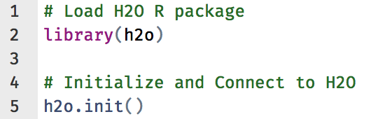
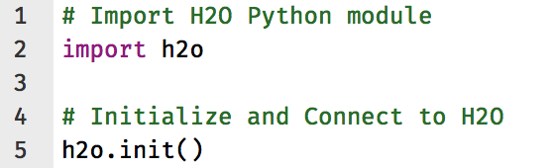
Other H2O Interfaces
Key Resources
R
Python
docs.h2o.ai

